Slide 1
Chapter 07 Flowchart of Single-camera Measurement
(Theme 2)
Prof. Lin ZHANG
School of Computer Science and Technology
Tongji University

Slide 2

Problem definition of single-camera measurement
Can you tell me the diameter of the coin shown in the image?

Slide 3
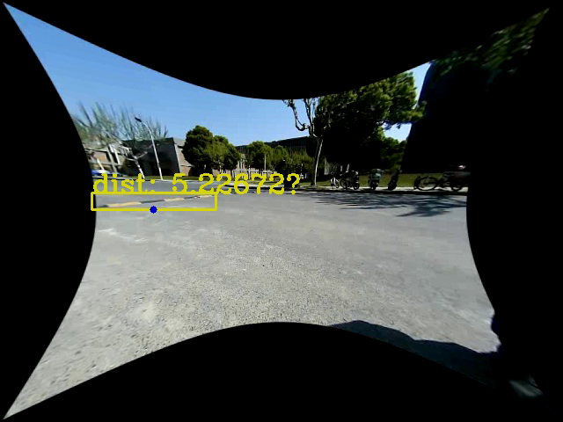
Problem definition of single-camera measurement
In this demo, the system detects persons and speed-bumps and outputs their horizon distances to the robot
Only one camera is used
How to achieve this goal?

Slide 4
Problem definition of single-camera measurement
To solve the aforementioned two problems, we need to have some assumptions
The object to be measured should locate on a (physical) plane
The imaging plane and the physical plane satisfy projective transformation, i.e., the imaging process should satisfy the ideal pin-hole camera model
There is a projective transformation matrix H linking the physical plane and the imaging plane. For a point x on the imaging plane, we can get its position on the physical plane as Hx

Slide 5
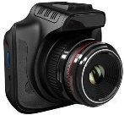
Problem definition of single-camera measurement
Imaging plane
(unit: pixel)
x
v
u
H
x
y
physical plane
(unit: mm)

Slide 6
Steps for achieving single-camera measurement
Calibrate the camera to get its intrinsic parameters
With the intrinsic parameters, un-distort the images to make the imaging process satisfy the ideal pin-hole imaging model
With a set of marker-points (their positions on the physical plane are known, and their images on the imaging plane are also known), get H
With H, for any point on the imaging plane, we can get its position on the physical plane

Slide 7
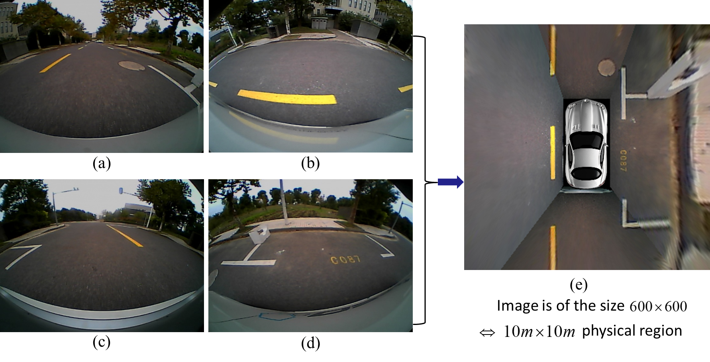
Steps for achieving single-camera measurement
With H, to go one step further, we can generate the bird’s-eye view of the physical plane, which is very useful to perform detection and measurement of plane objects
The geometric transformation between the physical plane and its bird’s-eye view is a similarity transformation

Slide 8
Steps for achieving single-camera measurement

Slide 9
Contents of this theme
To study the camera calibration algorithm, we need to have some knowledge about projective geometry, which will be introduced in Chapter 8
Camera calibration is a non-linear least-squares problem; Chapter 9 will formally define such a kind of problem and the algorithms to solve it
Imaging model and the camera calibration algorithm will be detailed in Chapter 10
In Chapter 11, we will learn how to generate the bird’s-eye view for the physical plane

Slide 10
Contents of this theme
应用
单目测距
平面目标测量
鸟瞰环视图
相机位姿估计
视觉里程计
场景三维重建
技术
相机内参标定
相机镜头畸变去除
鸟瞰视图构建
算法
相机成像流程建模
镜头畸变建模
相机内参平面标定法
逆透视投影
数学
射影几何
无穷远点与消失点
阻尼法
非线性最小二乘问题
凸函数
泰勒展开
列文伯格-马夸尔特法
高斯牛顿法
雅可比矩阵
罗德里格斯公式
旋转的轴角表达

Slide 11


